Slide 1

Artificial Intelligence and Its Applications: Shaping the Future of Technology in Tanzania
Dr Michael S. Mollel (PhD)
Co-Founder & CEO Sartify LLC

Slide 2
Overview of the Presentation
Context and Understanding
Introduction
Understanding Artificial Intelligence
Current State of AI Globally
AI in Tanzania
AI in Tanzania: Current Landscape
Applications of AI in Tanzania
Benefits of AI for Tanzanian Society
Challenges and Ethical Considerations
Strategies for Advancing AI in Tanzania
Case Studies and Success Stories
Future Outlook
Conclusion
Notes:
Slide 2: Welcome and Opening Remarks
A very warm welcome to all of you present here today for this insightful presentation on "Artificial Intelligence and Its Applications: Shaping the Future of Technology in Tanzania."
It is my honor to have the opportunity to discuss this highly relevant and transformative field that holds immense potential for driving technological advancements and economic growth in our nation.
Artificial Intelligence, or AI, has rapidly evolved from a theoretical concept to a powerful technology that is reshaping industries, businesses, and our daily lives.
In this presentation, we will explore the fundamentals of AI, its current applications across various domains, and its potential impact on Tanzania's technological landscape.
We will delve into the opportunities and challenges presented by AI, and how we, as a nation, can harness its capabilities to drive innovation, efficiency, and sustainable development.
By understanding the capabilities and implications of AI, we can better prepare ourselves to embrace this disruptive technology and position Tanzania as a leader in the digital revolution.
I encourage you all to engage actively throughout the presentation, as your insights and perspectives will contribute to a deeper understanding of this fascinating topic.

Slide 3
Introduction

Slide 4
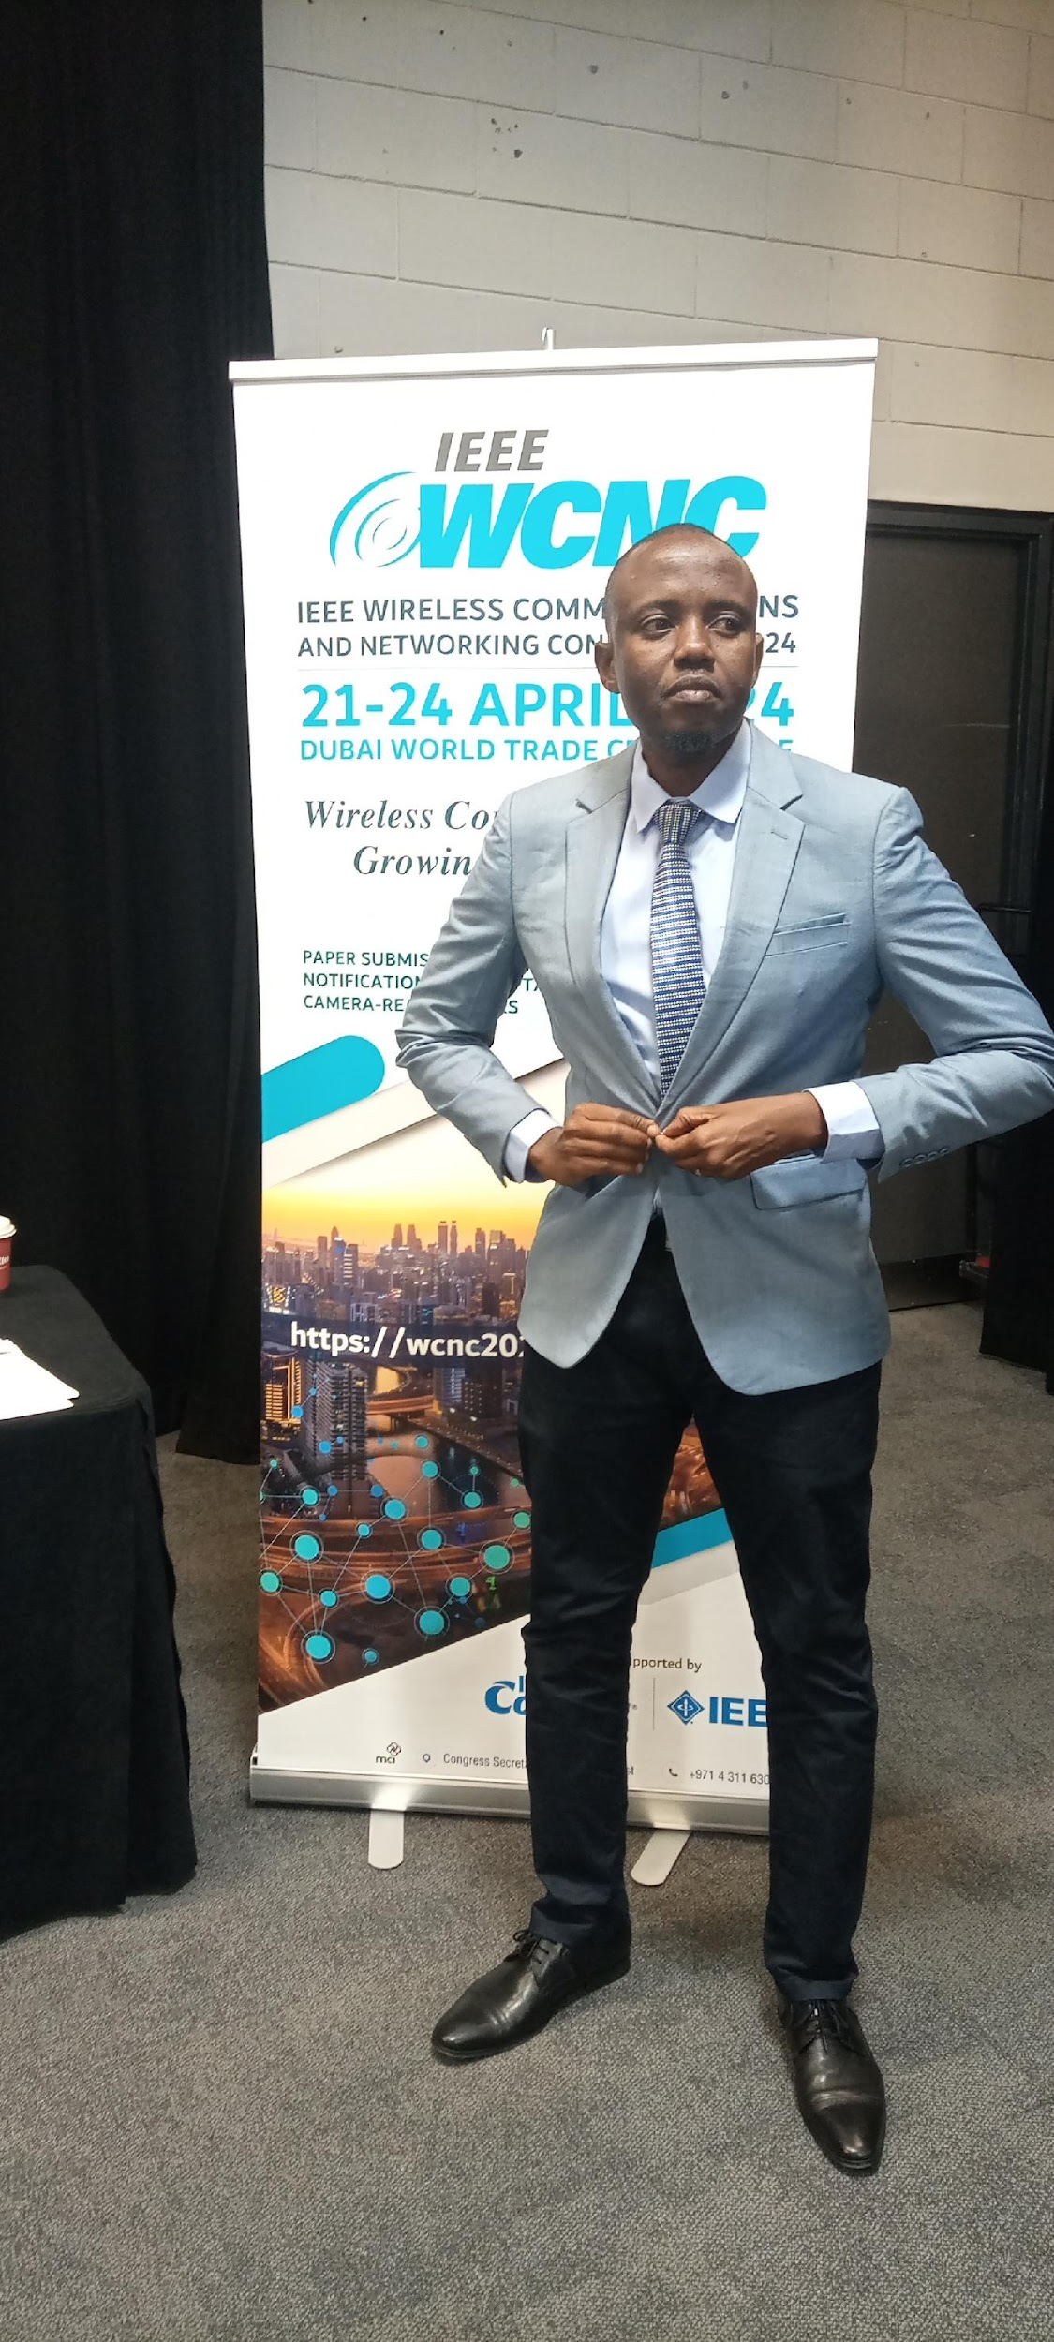
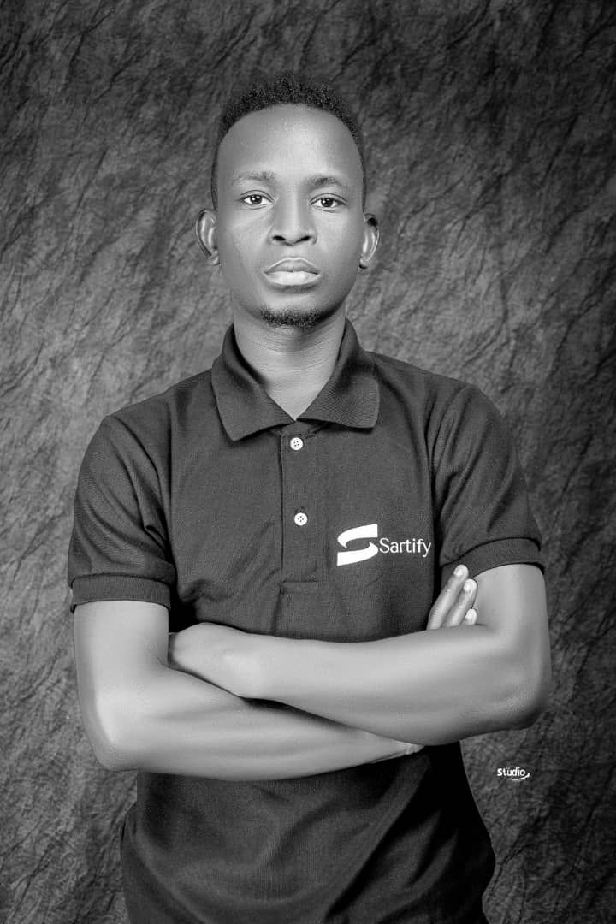
Sartify LLC (www.sartify.com)
Sartify LLC
Co-Founder & CE0
Co-Founder & CAIO

Slide 5
Sartify LLC (www.sartify.com)
About Sartify LLC
A deep AI technology company specializing in consultation, research, and AI-powered products
Delivers customized AI decision-making solutions for enterprises and consumers
Helps clients enhance customer experience, increase efficiency, reduce costs, boost revenue, and drive exponential growth
Offerings
Custom ML/AI Engineering (Computer Vision, NLP, Recommender Systems, etc.)
Advanced Data Analytics (Business Insights, Predictive Modeling, BI Dashboards)
Data & AI Strategy Consultation (Data Governance, AI Roadmap, Change Management)
AI Executive Training (Workshops, Business Opportunities, Talent Acquisition)
AI Research & various end-to-end products to advance the field and improve the life of people.

Slide 6
Sartify LLC
Some Of Our works & Impacts We have Created.
Our Current In-House Developing Products: Welcome to Join a Waitlist.
Docipro : Intelligent Document Processing Autopilot, a way to uncover valuable insights effortless from any unstructured data within complex manual business workflow- Powered by AI.
Fotopic : AI-powered photographic App. Instantly get quality photographic pictures for your single phone-taken photo. This cover different variations, lookings environment, clothes etc…
Resuma Platfrom : Brainstorm, Craft Profesional CV & Get your desired Job Instantly, all powered by AI (Docipro & Conversional AI).
Enterprise Custom Solutions:
Resume Parsing & Jobs Recommendations, Niajiri Platform Limited.
Customer’s Assistant ChatBot, AwamuPay.
iPFGPT - RAG Based System For iPF Softwares, iPF SOftwares.
Semantic Powered Search Feature & Products List Personalization, Biashara Plus Limited.
Research:
Open Source various Fine-tuned LLM for Swahili Language Example. Swahili Gemma, Llama, Mixtral etc.
AviLaMa : African Vision-Languages Pre-Training Model. [Learn Visual Concepts Directly From African Language Supervision, A work towards zero shot image retrieval and ranking tasks, zero image classification, visual QA & Conversational AI, Art & Image generation guiding & condition task, text image analysis and content moderation all done in our African Languages. ]
African Languages Datasets to power various LLM research & development in Africa.
A Cassava Categorization Way (Detection & Classification) with AI.
Swahili LLM Evaluation Benchmark Platform.

Slide 7
Sartify LLC
Reach Us
www.sartify.com
https://www.sartify.com/contact-us
info@sartify.com
Business/Enterprise Consultation, Executive Training and Talent Nurture in our community around AI, Data, Ethics and Strategy.
Various business. Eg. AwamuPay, iPF Softwares etc..
AI Engineering Workshops Eg. Neurotech’s GenAI Meetups.
etc…..

Slide 8
Understanding Artificial Intelligence

Slide 9
Definition and Basic Concepts
AI refers to the simulation of human intelligence processes by machines, particularly computer systems.
It involves developing systems that can perform tasks that typically require human intelligence, such as reasoning, learning, problem-solving, perception, and decision-making.

Slide 10
Definition and Basic Concepts
Key Concepts
Machine Learning: A subset of AI that enables systems to learn and improve from experience without being explicitly programmed. It uses algorithms and statistical models to analyze data and identify patterns.

Slide 11
Definition and Basic Concepts
Key Concepts
Neural Networks: Computational models inspired by the human brain's interconnected neurons. Consists of interlinked nodes (artificial neurons) that transmit signals and learn to recognize patterns. Form the backbone of Deep Learning algorithms.

Slide 12
Definition and Basic Concepts
Key Concepts
Deep Learning: A sophisticated form of Machine Learning inspired by the human brain's neural networks. Uses multi-layered artificial neural networks to learn from vast amounts of data. Excels in tasks like image and speech recognition and natural language processing.

